Slide 1
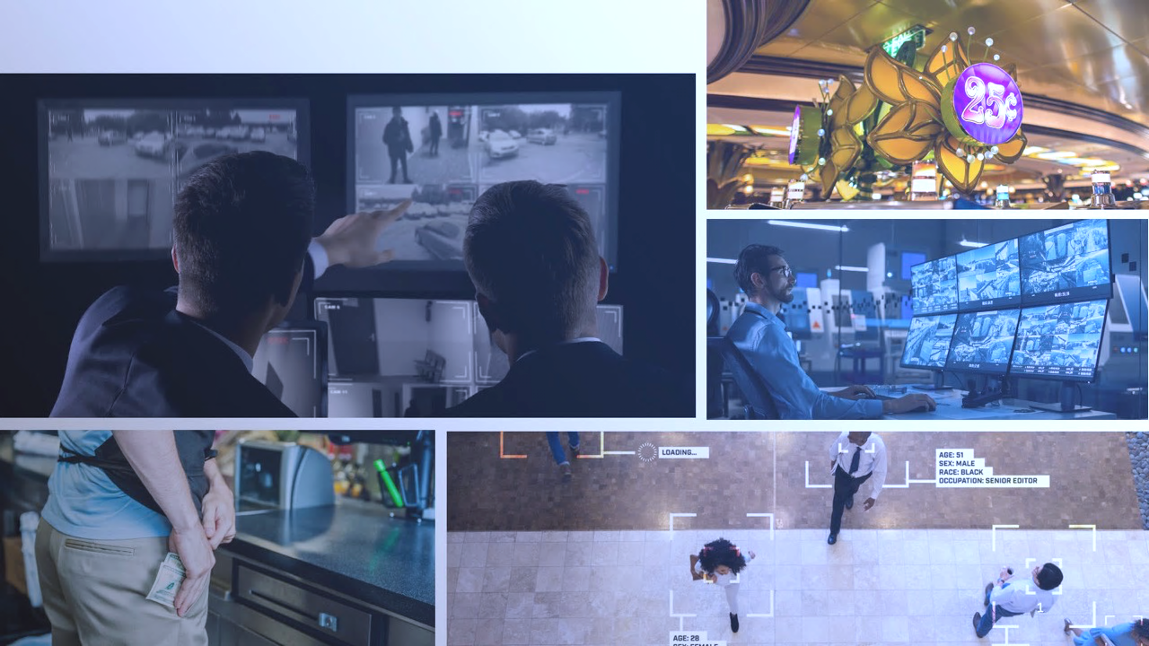


SIXTH ANNUAL INTERNATIONAL
2026 CASINO SURVEILLANCE
SURVEY WEBINAR REPORT

Slide 2
TABLE OF CONTENTS
Introduction 3
Methodology & Participation 4
Executive Summary 5
Section 1: Respondent Casino Characteristics 10
Section 2: Department Structure 14
Section 3: Wages and Budget 24
Section 4: Cheating Overview 31
Section 5: Advantage Play 39
Section 6: Internal Theft & Fraud 44
Section 7: Operations Trends 53
Section 8: Technology 64
Section 9: Top Threats 75
Conclusion 79
Reliability of Data 80

Slide 3
INTRODUCTION
The 2026 International Casino Surveillance Survey shows that surveillance departments are expanding beyond traditional observation roles. Technology, data, and intelligence are helping surveillance play a larger role in protecting assets, supporting investigations, and managing operational risk.
The 2026 International Casino Surveillance Survey is the gaming industry's only comprehensive benchmarking study dedicated exclusively to casino surveillance operations and marks its sixth consecutive year of publication.
Over six years, the survey has become the industry's leading source for measuring trends in surveillance operations, staffing, budgets, technology adoption, training, and emerging operational challenges.
The study provides year-over-year benchmarking across commercial, Tribal, cruise ship, and participating international gaming operations, enabling surveillance leaders to compare their organizations with industry peers and make more informed strategic and operational decisions.
This report includes:
Six years of trend data (2021–2026) covering staffing, compensation, budgets, operations, technology, training, and emerging threats
Benchmark comparisons by casino type and property size that provide context for year-over-year analysis
Research-based analysis highlighting significant industry trends, operational changes, and evolving surveillance practices.
Executive insights and practical recommendations that translate survey findings into operational strategies for surveillance leaders.

Slide 4
EXECUTIVE SUMMARY
Industry Trends Shaping Casino Surveillance in 2026
The 2026 International Casino Surveillance Survey reveals an industry that continues to expand its operational influence while adapting to increasingly sophisticated risks and rapidly evolving technology. Although surveillance departments remain focused on traditional priorities such as internal theft, advantage play, and cheating, the survey demonstrates a growing emphasis on intelligence-led investigations, advanced technology, information sharing, and enterprise-wide risk management.
Key Industry Trends
Casino surveillance continues to strengthen its strategic role, with many departments reporting strong access to executive leadership and increased involvement in operational decision-making.
Internal theft and fraud remain the industry's highest operational concern, identified by 92% of survey respondents, reinforcing the continued importance of proactive investigations and internal controls.
Advantage play, cheating, and cyber threats now represent the next tier of operational priorities, demonstrating the expanding scope of surveillance responsibilities.
Technology adoption continues to accelerate. Facial recognition usage has increased from 25% of responding properties in 2021 to 59% in 2026, while ID scanning solutions have grown to 67% of participating casinos.
Technology is delivering measurable operational value. More than 80% of properties using facial recognition reported a fairly large or huge positive impact on identifying criminal activity and undesirable individuals.

Slide 5
EXECUTIVE SUMMARY
KEY INDUSTRY TRENDS (continued)
• Information sharing and intelligence platforms have become standard investigative resources, improving collaboration and investigative effectiveness across jurisdictions.
• Operational reporting systems are widely available, yet survey results indicate that information analysis remains an area with significant opportunity for continued growth.
• Surveillance departments continue investing in both personnel and technology, reflecting the profession's evolution from traditional observation toward intelligence-driven operations.
Executive Perspective:
The survey findings indicate that casino surveillance is increasingly functioning as an enterprise risk management partner—combining experienced personnel, advanced technology, operational intelligence, and cross-functional collaboration to protect gaming operations, assets, employees, and guests.

Slide 6

EXPERT OPINION:
"Compensation remains one of the biggest challenges facing casino surveillance. While supervisor salaries continue to improve, agent and observer wages slipped slightly from last year's peak, reminding us that recruiting and retaining experienced personnel remains highly competitive. Larger properties continue to have an advantage in both compensation and available resources, while smaller operations must often accomplish the same mission with fewer people and tighter budgets. The survey also shows that many surveillance leaders have limited visibility into department and training budgets, reinforcing the importance of stronger communication between surveillance and executive management as departments continue to expand their operational role.“
Derk J. Boss, CFE, CPP, CSP
President, IACSP
SECTION THREE
WAGES
AND BUDGETS

Slide 7


Recommended best practices to increase wages, staff retention, and training budget:
Link wage progression directly to measurable training and certification achievements to reinforce skill development.
Create and maintain a property-specific surveillance knowledge base, supported by dedicated reading materials, peer discussions, and vendor-led workshops.
Develop a cross-departmental training model that incorporates gaming operations, internal audit, compliance, and AML, framing surveillance as a property-wide asset.
Partner with professional associations like IACSP and ASIS International to elevate industry credentials and establish benchmarking against peers.
Explore co-funding opportunities with surveillance, security, gaming, and marketing departments for specialized training or technology acquisition.
SECTION THREE
BEST
PRACTICES

Slide 8
.
SECTION 3 OVERVIEW: WAGES & BUDGETS
Analysis
Compensation results were mixed in 2026. The percentage of properties reporting agent/observer wages above $20 per hour declined from 50% to 43%, although it remains substantially higher than in 2021. Supervisor compensation continued to improve, with 59% reporting salaries above $50,000. Department and training-budget results were less conclusive because a large share of respondents selected “not sure.”
Key Findings
43% reported agent/observer wages above $20 per hour, down from 50% in 2025.
59% reported supervisor salaries above $50,000, up from 51% in 2025.
The share of departments with budgets of $500,000 or less remained at 12%.
Budget comparisons should be interpreted cautiously because 40% were unsure of their department budget and 34% were unsure of their training budget.
Larger properties generally reported higher compensation and greater budget capacity than smaller operations.
Why This Matters
Competitive compensation remains important for recruiting and retaining qualified surveillance personnel.
Limited visibility into department and training budgets makes year-over-year investment trends difficult to assess.
Smaller properties continue to face greater resource constraints than larger operations.

Slide 9
SECTION THREE:
WAGES AND BUDGETS
2026: Average hourly rate by gaming floor size
Hourly Rate for agent/observer | Less than 50,000 sf | 50,000 – 100,000 sf | More than 100,000 sf
Under $15 | 21% | 11% | 10%
$15 – $17 | 11% | 15% | 0%
$18 – $20 | 11% | 34% | 31%
More than $20 | 42% | 36% | 51%
Not sure | 16% | 4% | 8%
RESPONDENT COMMENTS
“update
** Respondent comments are not edited

Slide 10
SECTION THREE:
WAGES AND BUDGETS
2026: Supervisor salary by gaming floor size
Wage | Less than 50,000 sf | 50,000 – 100,000 sf | More than 100,000 sf
$25,000 – $30,000 | 5% | 6% | 8%
$30,001 – $40,000 | 26% | 6% | 5%
$40,001 – $50,000 | 16% | 28% | 5%
More than $50,000 | 42% | 55% | 74%
Not sure | 11% | 4% | 8%
RESPONDENT COMMENTS
** Respondent comments are not edited

Slide 11
SECTION THREE:
WAGES AND BUDGETS
2026: Annual surveillance department budget by gaming floor size
Department budget | Less than 50,000 sf | 50,000 – 100,000 sf | More than 100,000 sf
$500,000 or below | 17% | 11% | 10%
$500,001 – $1,000,000 | 22% | 11% | 0%
$1,000,001 – $2,000,000 | 11% | 30% | 26%
More than $2,000,000 | 0% | 9% | 23%
Not sure | 50% | 40% | 41%
RESPONDENT COMMENTS
“Surveillance is often overlooked/under valued by upper management because we are non-revenue generating. Being unable to get information/tools to help/improve our job is difficult. We are unable to get some programs with our budget, and even if other departments wanted to share the cost of such tools, budget restraints do not allow it. It is frustrating.”
** Respondent comments are not edited

Slide 12
SECTION THREE:
WAGES AND BUDGETS
2026: Annual surveillance training budget by gaming floor size
Annual budget | Less than 50,000 sf | 50,000 – 100,000 sf | More than 100,000 sf
None | 12% | 19% | 8%
Less than $1,000 | 6% | 4% | 13%
$1,000 – $5,000 | 6% | 28% | 18%
More than $5,000 | 29% | 19% | 28%
Not sure | 47% | 30% | 33%
RESPONDENT COMMENTS
“Training is key with technology and scams getting so advanced. With an extremely busy property training time is hard to come by. Employee retention has also been very challenging in recent years due to other opportunities where more money can be made. Raise the pay for the qualifications and workload to retain the good employees.”
** Respondent comments are not edited

Slide 13
DEFINITION OF CHEATING IN THIS SURVEY:
“For consistency across all annual casino surveillance surveys, ‘cheating’ refers to actions by an individual or group—acting independently or in collusion with casino employees—to obtain an unearned advantage over the casino through deception, manipulation, or unauthorized information.
Examples include:
Wagering after the outcome is known (past posting, top-hatting)
Obtaining protected information through deceptive or unauthorized means (such as card marking, hidden recording devices, or electronic assistance)
Receiving unearned benefits through collusion or manipulation of casino procedures (such as paid losing bets, false player ratings, or social engineering)
Additional examples include color-up scams, edge sorting, front-money scams, and other schemes intended to obtain an unfair advantage.
Derk J. Boss, CFE, CPP, CSP
President, IACSP
SECTION FOUR
CHEATING
OVERVIEW

Slide 14
SECTION 4: CHEATING OVERVIEW
Analysis
Cheating remains a core responsibility of casino surveillance, although the nature of incidents continues to evolve. Traditional game protection remains important, while surveillance departments increasingly rely on technology, training, and intelligence sharing to identify sophisticated cheating methods and organized activity.
Key Findings
Cheating remains one of the industry's top operational concerns, ranking among the highest surveillance priorities.
Survey responses indicate that technology-assisted investigations are becoming increasingly common.
Departments continue investing in training and operational procedures to address evolving cheating methods.
In 2026, 29% reported more than 15 cheating events, up from about 25% in 2025; live surveillance detection was 68%, surveillance investigation/audit 66%, and reporting by the involved department 61%.
Why This Matters
Cheating methods continue to evolve alongside advances in gaming technology.
Success increasingly depends on combining experienced investigators with modern surveillance technology.
Continuous training and information sharing remain essential to protecting game integrity.

Slide 15
SECTION FOUR:
CHEATING OVERVIEW
2026: Total cheating events in 2025 by gaming floor size
Number of events | Less than 50,000 sf | 50,000 – 100,000 sf | More than 100,000sf
0 – 5 | 47% | 34% | 23%
6 – 10 | 18% | 13% | 21%
11 – 15 | 2% | 11% | 13%
More than 15 | 12% | 32% | 36%
Not sure | 12% | 11% | 8%

Slide 16

SECTION FOUR:
CHEATING OVERVIEW
RESPONDENT COMMENTS
“It is common knowledge most cheating schemes originate outside of the USA, the greatest losses to casinos in the USA to my knowledge and what's reported by the media, have come via foreign visitors.”
(Multiple responses permitted.)
** Respondent comments are not edited

Slide 17
SECTION FOUR:
CHEATING OVERVIEW
(Multiple responses permitted.)

Slide 18
SECTION FOUR:
CHEATING OVERVIEW
(Multiple responses permitted.)

Slide 19
SECTION FOUR:
CHEATING OVERVIEW
Average amount of loss per cheating incident in 2025 by gaming floor size
Amount | Less than 50,000 sf | 50,000 – 100,000 sf | More than 100,000 sf
Less than $1,000 | 62% | 41% | 33%
$1,000 – $5,000 | 15% | 18% | 33%
$5,001 – $10,000 | 8% | 10% | 6%
$10,001 – $50,000 | 8% | 8% | 12%
More than $50,000 | 0% | 3% | 3%
Not sure | 8% | 21% | 12%

Slide 20
SECTION FOUR:
CHEATING OVERVIEW
Top line: percent of respondents
(Multiple responses permitted.)

Slide 21
DEFINITION OF ADVANTAGE PLAY IN THIS SURVEY:
“By advantage play, we mean an individual or group of individuals who gain an advantage over casino games without actively violating laws or casino policies and procedures. Examples include card counting without the use of a device, baccarat side-bet counting, placing roulette bets late in the spin, and exploiting visible bonus features on slot machines when doing so becomes profitable.”
Derk J. Boss, CFE, CPP, CSP
President, IACSP
SECTION FIVE
ADVANTAGE
PLAY

Slide 22
SECTION 5 OVERVIEW: ADVANTAGE PLAY
Analysis
Advantage play continues to be one of the most significant challenges facing casino surveillance departments. Survey results indicate that organized teams, evolving techniques, and increased operational sophistication require surveillance professionals to combine traditional observation skills with intelligence sharing, technology, and specialized investigative training.
Key Findings
Advantage play remains among the highest-ranked surveillance concerns, cited by 53% of respondents in the Top Threats section.
41% of respondents reported more than 20 advantage-play incidents in the previous calendar year, up from 34% in 2025 and 20% in 2021.
Blackjack was the most frequently reported area of advantage play (80%), followed by slots (42%).
Advantage play was most commonly detected through surveillance live detection (76%), followed by surveillance investigation/audit (64%) and reporting by the involved department (55%).
Why This Matters
Advantage play continues to evolve, requiring surveillance teams to adapt their investigative strategies.
Intelligence sharing and timely information exchange improve the ability to identify repeat offenders and organized groups.
Ongoing training and operational consistency are critical to protecting gaming assets and maintaining game integrity.

Slide 23
SECTION FIVE:
ADVANTAGE PLAY
2026: Advantage play incidents per property in 2025 by gaming floor size
Number of Incidents | Less than 50,000 sf | 50,000 – 100,000 sf | More than 100,000 sf
None | 19% | 11% | 3%
1 – 5 | 25% | 18% | 9%
6 – 10 | 13% | 18% | 9%
11 – 20 | 0% | 16% | 17%
More than 20 | 31% | 32% | 60%
Not sure | 13% | 5% | 3%

Slide 24
SECTION FIVE:
ADVANTAGE PLAY
(Multiple responses permitted.)

Slide 25
SECTION FIVE:
ADVANTAGE PLAY

Slide 26
DEFINITION OF INTERNAL THEFT/FRAUD IN THIS SURVEY:
"By internal theft and fraud, we mean instances in which employees or staff members directly steal money, assets, or other items of value from the casino operation through any method.
Examples include slot employees producing and cashing fraudulent 'test' TITO vouchers for personal gain, employees exploiting marketing promotions to benefit themselves, friends, or family members, dealing staff stealing chips, and hospitality employees stealing cash payments for food or beverages."
Derk J. Boss, CFE, CPP, CSP
President, IACSP
SECTION SIX
INTERNAL
THEFT/FRAUD

Slide 27
SECTION 6 OVERVIEW: INTERNAL THEFT/FRAUD
Analysis
Internal theft and fraud remain among the most significant risks facing casino surveillance departments. Survey results indicate that employee theft continues to require substantial investigative resources, with surveillance teams relying on proactive monitoring, video review, and interdepartmental cooperation to identify and investigate incidents.
Key Findings
Internal theft/fraud remains a top investigative priority for surveillance departments.
Surveillance continues to play a critical role in detecting, documenting, and investigating employee theft.
Video review, operational reporting, and cooperation with other departments remain the primary investigative tools.
Survey findings demonstrate the continued importance of strong internal controls and consistent investigative procedures.
Why This Matters
Employee theft represents an ongoing financial and operational risk for every casino.
Effective investigations depend on close coordination between surveillance, compliance, human resources, and operational management.
Proactive monitoring and consistent investigative practices help reduce losses while supporting organizational integrity.

Slide 28
SECTION SIX:
INTERNAL THEFT/FRAUD
2026: Cases of internal theft/fraud in 2025 by gaming floor size
Cases | Less than 50,000 sf | 50,000 – 100,000 sf | More than 100,000 sf
None | 6% | 12% | 3%
1 – 5 | 63% | 51% | 47%
6 – 10 | 19% | 21% | 18%
11 – 20 | 6% | 7% | 18%
More than 20 | 0% | 5% | 12%
Not sure | 6% | 5% | 3%

Slide 29

SECTION SIX:
INTERNAL THEFT/FRAUD
(Multiple responses permitted.)

Slide 30

SECTION SIX:
INTERNAL THEFT/FRAUD
RESPONDENT COMMENT
“Employee with customers, most dangerous collusion.”
(Respondents were asked to choose the top three means of detecting employee theft/fraud at their property in 2025.)
** Respondent comments are not edited

Slide 31
SECTION SIX:
INTERNAL THEFT/FRAUD
2026: Average loss per incident to employee theft/fraud in 2025 by gaming floor size
Loss Amount | Less than 50,000 sf | 50,000 – 100,000 sf | More than 100,000 sf
Less than $1,000 | 73% | 62% | 48%
$1,000 – $5,000 | 7% | 13% | 24%
$5,001 – $10,000 | 7% | 15% | 15%
$10,001 – $50,000 | 0% | 3% | 3%
More than $50,000 | 7% | 0% | 0%
Not sure | 7% | 8% | 9%

Slide 32

SECTION SIX:
INTERNAL THEFT/FRAUD
RESPONDENT COMMENTS
“As a Tribal enterprise, we frequently assist Tribal Police in investigations (whether it be for an on-property investigation or with investigations un-related to the Casino). Our property also has control over the Surveillance cameras at other Tribal enterprises and buildings, such as the Government Complex, Community Center, Camp, Gas Station, Storage Barns, Roads, etc. We are currently working on having access and licenses to pilot drones to be able to assist Tribal Police when necessary and access to LEIN (law enforcement investigation network) to be able to provide additional investigative assistance to Tribal Police. “
** Respondent comments are not edited
(Multiple responses permitted.)
** Respondent comments are not edited

Slide 33
SECTION SIX:
DETECTION COMPARISONS
This chart and the two charts on the next page show how the top three methods of detection for cheating incidents, advantage play incidents, and employee theft/fraud incidents have shifted from 2021 to 2026.

Slide 34
SECTION SIX:
DETECTION COMPARISONS

Slide 35
EXPERT OPINION:
“Table games remain the primary focus of casino surveillance because of their volatility and revenue sensitivity. At the same time, other risk domains—including guest-related incidents, AML compliance, employee theft and fraud, and human trafficking—continue to grow in importance.
The expansion of electronic table games is expected to require additional surveillance resources and greater slot surveillance expertise. While live observation and video review continue to account for much of a surveillance department's operational workload, the gradual adoption of information analysis and data analytics reflects a shift toward more proactive threat detection. Forward-thinking surveillance departments are increasingly leveraging data to identify risks earlier and improve operational efficiency.
Persistent state slot machines (PSMs) and electronic table games (ETGs) continue to emerge as operational trends deserving increased surveillance attention.”
Derk J. Boss, CFE, CPP, CSP
President, IACSP
SECTION SEVEN
OPERATIONS
TRENDS

Slide 36
DEFINITION OF PERSISTENT STATE SLOT MACHINES IN THIS SURVEY:
Persistent state slot machines (PSMs) are gaming machines in which certain game features, progress, or "states" persist between plays or player sessions. Unlike traditional slot machines, which reset completely after every spin, persistent state slot machines retain information such as:
Accumulated bonus progress (e.g., partially filled bonus meters).
Unlocked special features or multipliers.
Progress toward “must-hit-by” jackpots.
DEFINITION OF ELECTRONIC TABLE GAMES (ETGs) IN THIS SURVEY:
Electronic table games (ETGs) are digital or hybrid versions of traditional table games such as blackjack, roulette, baccarat, and craps. ETGs may:
Use a virtual display with RNG-based outcomes (fully electronic).
Combine a physical dealer or mechanical components with electronic betting stations (hybrid ETGs).
They aim to replicate the table game experience while allowing multiple players to participate simultaneously, often at lower bet minimums.
SECTION SEVEN
OPERATIONS
TRENDS

Slide 37
VULNERABILITIES TO SLOT ADVANTAGE PLAYERS AND CHEATS
Persistent State Slot Machines
1. Advantage play vulnerability
Advantage players can “machine scout” for games left in a favorable state (e.g., nearly full bonus meter) and only play when the expected value is positive.
This can result in casinos losing theoretical hold over time.
2. Predictable progression exploits
If the game’s bonus trigger is deterministic or predictable after a set number of spins, experienced players can time entry and avoid low-value states.
3. Cheating Risks
Tampering with software or hardware to falsely display a high-progress state.
Collusion with insiders to identify machines in profitable conditions.
Electronic Table Games
1. Software vulnerabilities
RNG exploitation if algorithms are predictable or improperly seeded.
Display manipulation to alter results or payouts.
2. Betting pattern exploits
If system timing allows delayed wagers after outcome determination due to latency issues.
3. Physical manipulation (hybrid ETGs)
If mechanical elements like roulette wheels are predictable or manipulated, advantage players can exploit bias detection.
SECTION SEVEN
OPERATIONS
TRENDS

Slide 38
Recommended best practices to improve overall operations:
Conduct a comprehensive risk assessment using a probability-impact model to identify and prioritize critical operational threats.
Develop and maintain a property-wide surveillance audit schedule to ensure complete coverage across all gaming and non-gaming operations.
Incorporate data analytics roles into the department structure to detect emerging fraud patterns and compliance gaps before they escalate.
Use a balanced mix of live observation, retrospective review, and analytical reporting for balanced coverage.
SECTION SEVEN
BEST
PRACTICES

Slide 39
Recommended best practices for persistent state slot machines:
Monitor and identify consistent winners.
Monitor player time on device as extended play on a single machine may indicate persistent-state advantage play.
Observe players for behavioral indicators of slot advantage play.
Track and analyze player patterns for “cherry-picking” behaviors.
Data monitoring: Use analytics to flag abnormal win rates or unusual betting patterns.
SECTION SEVEN
BEST
PRACTICES

Slide 40
Recommended best practices for electronic table games (ETGs):
Monitor and identify consistent winners.
Observe players for behavioral indicators of advantage play on electronic table games.
Ensure certified, regularly audited RNGs with cryptographically secure seeding.
Latency management: Close betting before outcome determination.
Hardware integrity checks: Regularly inspect and calibrate physical components to prevent bias exploitation.
Data monitoring: Use analytics to flag abnormal win rates or unusual betting patterns
SECTION SEVEN
BEST
PRACTICES

Slide 41
SECTION 7 OVERVIEW: OPERATIONS TRENDS
Analysis
Survey results show that surveillance departments continue to devote most operational resources to live observation and video review. While reporting systems and operational databases are widely available, information analysis represents a smaller portion of daily activities, indicating an opportunity to further leverage surveillance intelligence.
Key Findings
Reviews (38%) remain the primary method of detecting incidents, followed by live patrol (22%).
93% of departments use daily reporting systems, while 83% utilize slot data systems.
37% of respondents spend only 0–10% of their time conducting information analysis.
Operational reporting tools are widely available across surveillance departments.
Why This Matters
Traditional surveillance activities continue to dominate daily operations.
Existing reporting systems provide opportunities to expand intelligence-led investigations.
Increasing analytical capabilities may improve operational efficiency and investigative effectiveness.

Slide 42
SECTION SEVEN:
OPERATIONS TRENDS
Respondents ranked the following areas in order of importance for priority of security and surveillance resources.
The list is in descending order of importance:
Survey respondents ranked the list below in order of which type of operation creates the most impactful decision.
The list is in descending order of importance:
Guests
Reviews
Table games
Live patrol
Food and beverage
Video audit
Slots
Information analysis
Other
Other

Slide 43
SECTION SEVEN:
OPERATIONS TRENDS
(Percent of total respondents who chose each answer)

Slide 44
SECTION SEVEN:
OPERATIONS TRENDS

Slide 45
SECTION SEVEN:
OPERATIONS TRENDS

Slide 46
EXPERT OPINION:
“Facial recognition technology has moved beyond early adoption to become a proven operational tool within casino surveillance. Survey results show implementation increasing from 25% in 2021 to 59% in 2026, while a majority of remaining non-users plan future investment.
More importantly, more than eight in ten respondents report that facial recognition has had a fairly large or huge impact on detecting criminal and undesirable activity, reinforcing its value as a proactive security capability.
As surveillance departments continue integrating facial recognition with intelligence databases and analytics platforms, success will increasingly depend on effective data management, sound operational policies, and trained personnel who can transform alerts into timely investigative action.”
Derk J. Boss, CFE, CPP, CSP
President, IACSP
SECTION EIGHT
TECHNOLOGY

Slide 47
Recommended Best Practices to approach technology:
Deploy FR and license plate recognition (LPR) as part of a structured threat identification program, ensuring that reference databases are accurate, up-to-date, and legally compliant.
Build operational playbooks for each technology—detailing alert response procedures, evidence collection standards, and integration with security and law enforcement protocols.
Maintain ongoing technical and operational training for staff to optimize technology use and ensure compliance with privacy laws.
SECTION EIGHT
BEST
PRACTICES

Slide 48
SECTION 8 OVERVIEW: TECHNOLOGY
Analysis
Survey results indicate continued growth in the adoption of surveillance technologies, particularly facial recognition, ID scanning, and intelligence-sharing platforms. Respondents also reported that these technologies are improving investigative effectiveness while supporting more proactive surveillance operations.
Key Findings
59% of responding casinos now utilize facial recognition technology, up from 25% in 2021.
67% of properties report using ID scanning solutions.
82% of facial recognition users reported a fairly large or huge impact on detecting criminal activity and undesirable individuals.
Intelligence-sharing platforms such as the Oregon Surveillance Network (63%) and eConnect (58%) continue to support investigations.
Why This Matters
Technology has become an integral component of modern surveillance operations.
Advanced investigative tools are improving detection capabilities while supporting more efficient investigations.
Continued investment in technology requires corresponding investments in training, data management, and operational integration.

Slide 49

SECTION EIGHT:
TECHNOLOGY
RESPONDENT COMMENTS
“Technology brings more trust in agents.”
(Multiple responses permitted.)
** Respondent comments are not edited

Slide 50
SECTION EIGHT:
TECHNOLOGY
2026: Percent of casinos using facial recognition technology by gaming floor size
Facial technology usage | Less than 50,000 sf | 50,000 – 100,000 sf | More than 100,000 sf
Yes | 53% | 56% | 80%
No | 42% | 44% | 10%
Not sure | 0% | 0% | 2%
2026: Percent of casinos using facial recognition technology by type of casino
Facial technology usage | Commercial | Tribal
Yes | 62% | 63%
No | 38% | 28%
Not sure | 0% | 2%
Notes:
Yes 39% 21% 37% 51% No 59% 75% 63% 45% Not sure 2% 4% 0% 4%

Slide 51

SECTION EIGHT:
TECHNOLOGY

Slide 52
SECTION EIGHT:
TECHNOLOGY
(This question was only answered by casinos that did nor currently have facial recognition technology.)
RESPONDENT COMMENTS
“I feel Surveillance is being recognized as the information "cash cow" that it is, and is invaluable to operators.”
(Future investment plans were not included in the 2021 survey.)
** Respondent comments are not edited

Slide 53
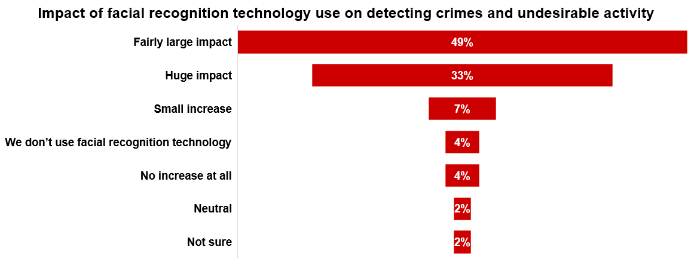
SECTION EIGHT:
TECHNOLOGY

Slide 54
SECTION EIGHT:
TECHNOLOGY
2026: Percent of properties with ID scan solution by type of casino
Usage | Commercial | Tribal
Yes | 69% | 67%
No | 25% | 20%
Not sure | 6% | 13%
Veridocs is the clear top system used, and Veriscan is second in systems being used in 2026.
(ID scan question was not included in the 2021 survey.)

Slide 55
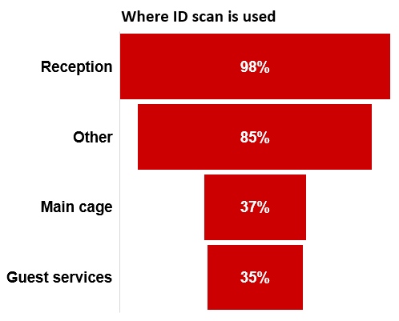
SECTION EIGHT:
TECHNOLOGY

Slide 56
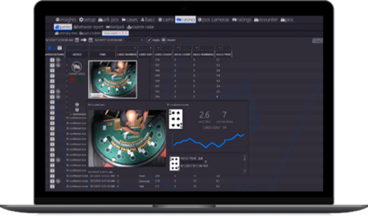
SECTION EIGHT:
TECHNOLOGY
*eConnect is one of the sponsors of this survey. Their sponsorship in no way influenced the data collection, analysis, or reporting of information, nor will it be used in any sales capacity.

Slide 57
LOOKING AHEAD
The 2026 International Casino Surveillance Survey demonstrates that surveillance is evolving from a reactive monitoring function into a strategic partner in enterprise risk management. While traditional responsibilities—including internal theft, cheating, and advantage play—remain central to the profession, today’s surveillance departments are increasingly expected to leverage technology, intelligence, and cross-functional collaboration to protect casino operations.
The survey also highlights continued investment in people, training, and technology. Organizations that successfully integrate skilled personnel with advanced investigative tools will be best positioned to address an increasingly complex operational environment.
THE FUTURE OF CASINO SURVEILLANCE
The International Casino Surveillance Survey continues to serve as the gaming industry's leading benchmark for measuring operational excellence, identifying emerging trends, and supporting informed decision-making for surveillance professionals worldwide.

Slide 58


iacsp.org
STARTING NOW!
The 2026 Cybersecurity Survey
11 multiple choice questions
Can be completed in about five minutes
Guaranteed anonymity for all respondents
Scan the QR code or use the survey link below:
IACSP 2026 CYBERSECURITY SURVEY
All webinar attendees today will receive an email invitation soon with the survey link.

Slide 59

iacsp.org
econnectglobal.com
betravingknows.com
tgandh.com
For questions or additional information about this report, contact:
Dan Cox, Client Services Manager | dan@betravingknows.com
Tel: 775-329-7864 | Cell: 503-444-1971
Raving — Reno, NV 89503 | Betravingknows.com

